Slide 1

LIMIT INFINITY 2017

Slide 2
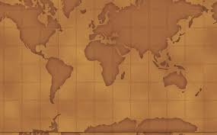
ROUND 2
IDENTIFY THE COUNTRY

Slide 3

Rules

Slide 4

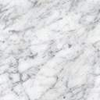
1
2
3
4
5
6

Slide 5
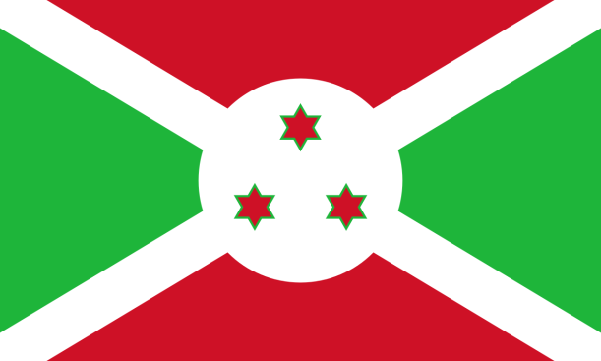
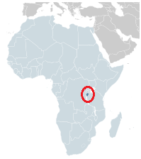
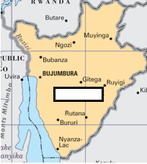
START
1
Capital: Bujumbura | Location: East Africa
one of the poorest countries in the world | Official Languages Kirundi, French

Slide 6

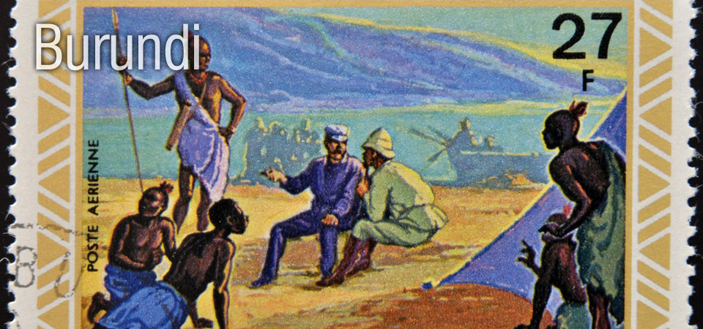
ANSWER
BURUNDI

Slide 7

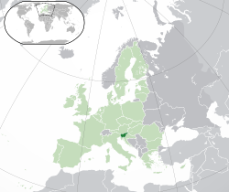
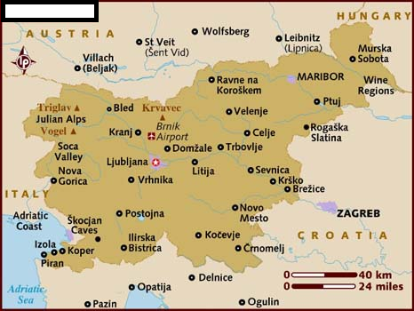
START
2
Capital: Ljubljana | Location: Central Europe
It was once a part of Yugoslavia | Melania Trump is from this country.

Slide 8
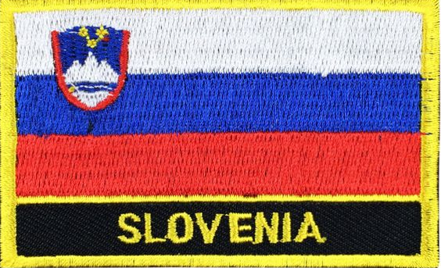
ANSWER
SLOVENIA

Slide 9

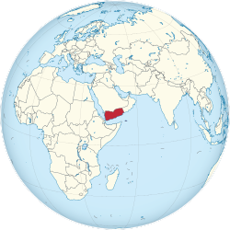
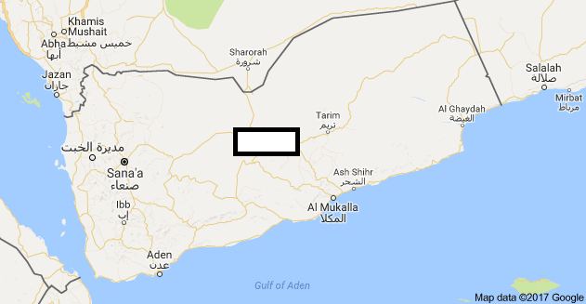
START
3
Capital: Sana’a | Location: South-West Asia
There is a civil war currently taking place here. | Currency: Rial

Slide 10
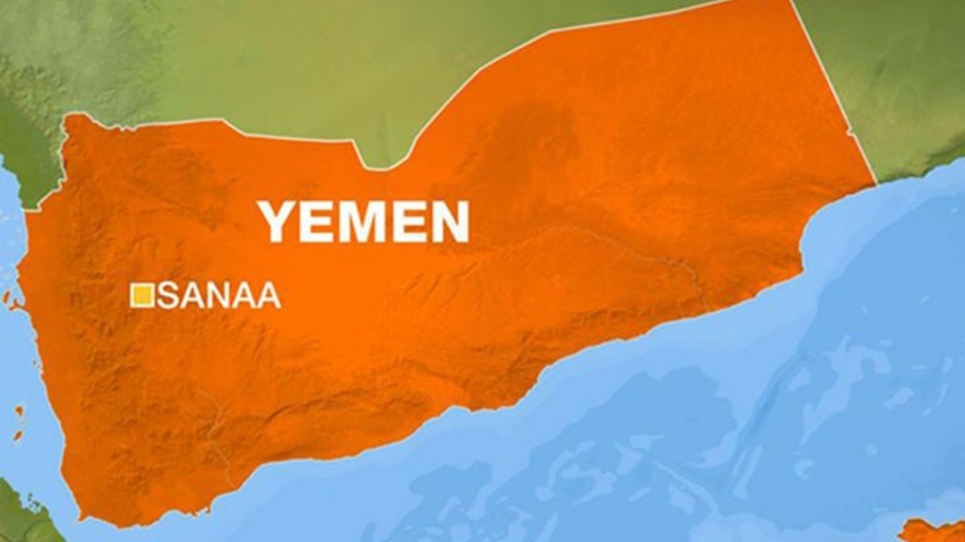
ANSWER
YEMEN

Slide 11

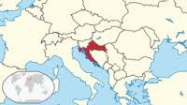
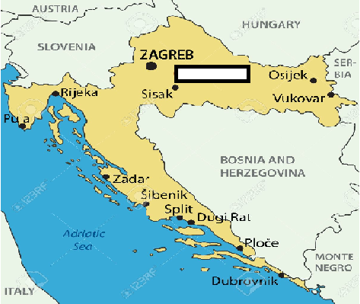
START
4
Capital: Zagreb | Location: South-East Europe
Major parts of the popular ‘Game of Thrones’ series including the ‘King’s landing’ scene was filmed here. | Currency: Kuna

Slide 12
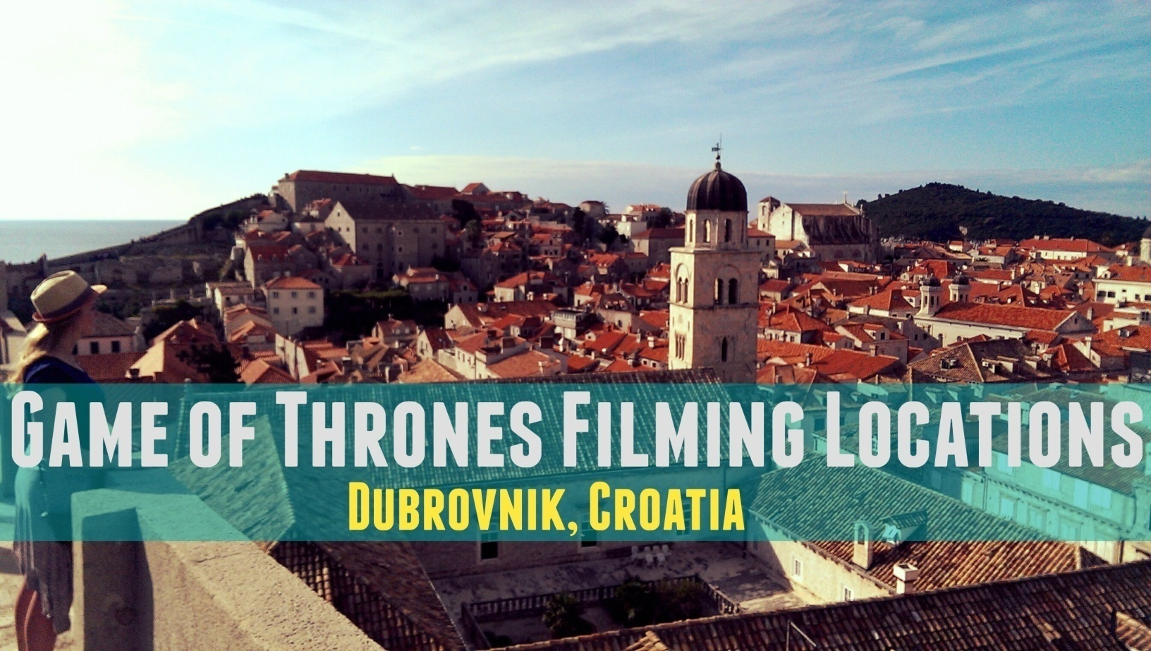
ANSWER
CROATIA

Slide 13
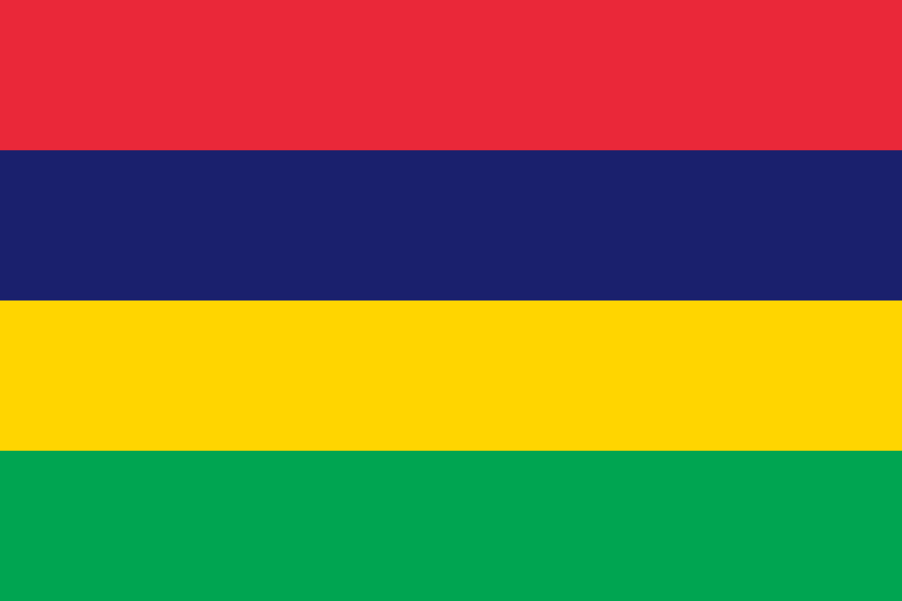
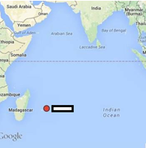
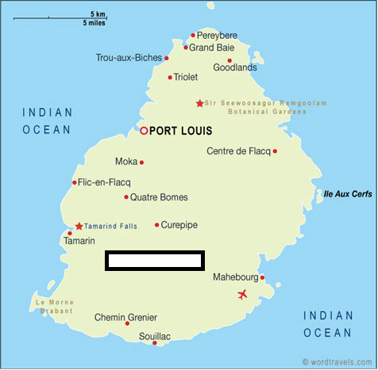
START
5
Capital: Port Louis | Location: Southern Africa
The dodo was endemic to this island nation. | Currency: Rupee

Slide 14
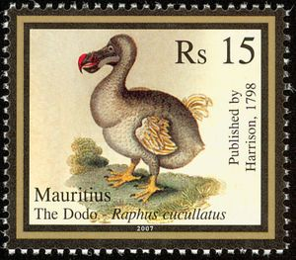
ANSWER
MAURITIUS

Slide 15
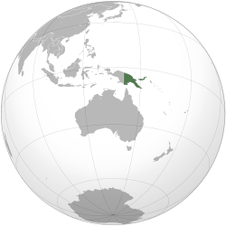

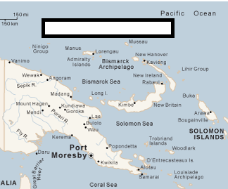
START
6
Capital: Port Moresby | Location:
Seashells were their national currency till 1933. | Currency: Kina

Slide 16
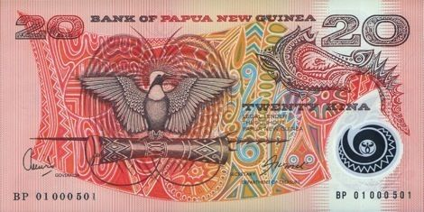
ANSWER
PAPUA NEW GUINEA

Slide 17
ROUND 3
CHOOSE

Slide 18
Rules

Slide 19


TEAM 1
Aeon
Yazoo
Mohs
Surf
Rift
Radio
Fjord
Coal
Agate
Nappe
Fault
Ruby

Slide 20

1. Mass of rock thrust a considerable distance.
2. It is produced as a wave steepens and falls forward as the wave nears the shore.
3. ___carbon; method for dating an object containing organic material

Slide 21
4. Red gem variety of Corundum.
5. One of four time spans in geochronology, lasting half a billion years or more
6. Banded siliceous rock

Slide 22
7. A valley caused by extension of the Earth’s crust
8. Fracture with relative displacement
9. Glacial valley flooded by the sea
10. Ten-point scale of mineral hardness

Slide 23
TEAM 2
Amethyst
Zeolites
Varve
Well
Mantle
Epicenter
Oxbow
Joint
Chalk
Pipe
Arch
Soil

Slide 24
1. Landform created by an abandoned meander
2. All unconsolidated materials above bedrock
3. Purple variety of Quartz
4. Layer of the earth between crust and core

Slide 25
5. A vertical conduit through the Earth’s crust below a volcano, through which magma has passed
6. Point on earth's surface above earthquake focus
7. Surface of fracture in rock without parallel displacement

Slide 26
8. Bridge-like formation along a coast made by wave erosion cutting through both sides of a headland
9. Porous rock composed of the mineral calcite
10. Hydrous Aluminium silicate minerals

Slide 27
TEAM 3
Caldera
Kaolinite
Unconformity
Drift
S-Wave
Vug
Dome
Lava
Spit
Index
Load
Shale

Slide 28
1. The amount that a stream carries at any one time
2. Basin shaped volcanic depression
3. Molten rock that flows at the Earth’s surface
4. Surface of erosion separating younger strata from older rocks

Slide 29
5. A sandy bar built out from the land into a body of water
6. Type of fossil used to date the strata in which it is found
7. Common clay mineral-hydrous Al silicate

Slide 30
8. An uplift or anticlinal structure, roughly circular in its outcrop exposure, in which beds dip gently away from the centre in all directions
9. Seismic ripple which follows its primary counterpart
10. Material transported and deposited by wind

Slide 31
TEAM 4
Reef
Groin
Xenolith
Glacier
Humus
Névé
Cave
Rock
Karst
Halite
Loess
Jurassic

Slide 32
1. Wall built to limit the movement of sediment carried by long shore currents
2. Mass of ice moving through valley
3. Loosely compacted wind blown sediment
4. Granular ice formed by the recrystallization of snow

Slide 33
5. Landscape formed by action of ground water on soluble rocks
6. Dark part of soil from the decay of organic matter
7. Bar of rock, sand, coral or similar material, lying beneath the surface of water

Slide 34
8. Foreign rock inclusion in igneous rock
9. Middle part of Mesozoic Era
10. A natural open space underground, commonly caused by the dissolution of soluble rocks, generally limestone

Slide 35
5
Magma
Horn
Z Bend
Epoch
Wisconsin
Water
Delta
Levee
Water
Talus
Basalt
Plate

Slide 36
1.___ Table; surface beneath which rocks/soil are saturated
2. Rigid segment of the Earth’s lithosphere
3. Sharp spire of rock formed as glaciers in several cirques erode into a central mountain peak

Slide 37
4. Bank of sand and silt built by incremental deposition
5. Triangular deposit of sediments at river mouth
6. Molten rock containing dissolved gases and solid particles

Slide 38
7. Section of sandstone gorge in Kalbarri National Park popular with tourists
8. Dark fine-grained volcanic rock
9. Deposit at the base of a cliff formed by falling debris
10. Division of geologic time shorter than a period

Slide 39
Team 1:
Nappe, Surf, Radio, Ruby, Aeon, Agate, Rift, Fault, Fjord, Mohs
Team 2:
Oxbow, Soil, Amethyst, Mantle, Pipe, Epicenter, Joint, Arch, Chalk, Zeolites
Team 3:
Load, Caldera, Lava, Unconformity, Spit, Index, Kaolinite, Dome, S-Wave, Drift
Team 4:
Groin, Glacier, Loess, Neve, Karst, Humus, Reef, Xenolith, Jurassic, Cave
5:
Water, Plate, Horn, Levee, Delta, Magma, Z Bend, Basalt, Talus, Epoch

Slide 40
What is the name of the mountain chain in north Africa, whose highest peak is Toubkal?AtlasWhat Canadian province has the capital of Edmonton?AlbertaWhich is the world's largest peninsula, with an area of 3,237,500 km²?ArabianWhich continent is host to the world's largest desert?AntarcticaCan you name the sea in the map above?AdriaticWhich waterfall, the world's highest at 979m, is located in Venezuela?Angel FallsThe Acropolis is found in which European city?AthensWhich Caribbean island forms a part of the Kingdom of the Netherlands?ArubaCan you name the country whose flag is in the images above?Antigua and BarbudaWhat is the alternate name for 'Uluru', the sandstone feature in central Australia?Ayers RockWhich major river accounts for a fifth of the world's total river flow?AmazonCan you name the landmark in the image above?AlcatrazWhat is the name given to a cluster or group of islands?ArchipelagoWhat is the third most spoken of South Africa's eleven official languages?AfrikaansWhat is the name of the group of Portuguese islands near the mid-Atlantic Ocean?AzoresCan you name the country whose outline is in the images above?Austria

